Slide 1
Data 205 Lecture 10
Hypothesis Testing II
Yinxian Zhang
Assistant Professor of Sociology
Queens College, CUNY

Slide 2
Reminders about TA resources
Nikodem Bisaga
NIKODEM.BISAGA94@qmail.cuny.edu
Office hours:
Tuesdays: 11 am-12 pm (Zoom)
Zoom link: https://zoom.us/j/9793514647?pwd=bqS1cOzvkkoHFr0f72khvfGq1qmm7V.1
Devin Rodas
devin.rodas77@qmail.cuny.edu
Office hours:
Sundays: 1-3 pm (Email Devin for Zoom links)

Slide 3
Today’s Content
Hypothesis Testing with R
Understanding R outputs
Two Extensions of Hypothesis Testing
one-tailed v.s. two-tailed
one-sample v.s. two-sample (a/b test)

Slide 5
Recap: hypothesis testing in a nutshell
To perform a hypothesis testing is to…
Compare a hypothesized population parameter (a guess) to the sample statistic (deemed as “ground truth”).
If they are significantly different, i.e., the test statistic (the Z/t-score of the sample mean/proportion) falls outside the critical value interval (the Z/t-scores bracketing the 95% or 99% confidence level). E.g.:
  It means the probability for us to observe this sample mean is very low (below 5% or 1% chance) if H0 were true → reject H0 and “accept” H1.
On the contrary, if the test statistic falls within the critical value interval, we fail to reject (“accept”) H0.
If a sample mean has a Z-score of:
1.32
-2.06
2.79
…
-1.96 (or -2.58)
1.96 (or 2.58)
95% (or 99%) confidence level

Slide 6
Recap: 6 Steps of hypothesis testing
(0) Organize your information about the hypothesized population parameter (e.g. population mean, given in the hypothesis), the sample statistic (e.g., sample mean, often calculated by yourself), and the confidence level (the alpha level).
(1) Construct Null Hypothesis (H0) and Alternative Hypothesis (H1).
  H0: There is no actual difference between the sample mean/percentage and the hypothesized population mean/percentage. → The hypothesized population mean/percentage is likely to be “True”.
  H1: There is a significant difference between the sample mean/percentage and the population mean/percentage. → The hypothesized population mean/percentage is likely to be “False”.
(2) Determine the critical values (the Z-scores or t-scores that bracket the 95% or 99% CI).
  Is your sample >= 100? Yes → Z-scores; No → t-scores (look-up table)
  What is your confidence level? (95% or 99%)
(3) Calculate the test statistic (the Z-score or t-score of the specific sample mean/percent).
  Essentially, it is the number of SEs this sample mean/percentage is from the hypothesized population mean/percentage.
  Different formula for numerical v.s. categorical variables.

Slide 7
Recap: 6 Steps of hypothesis testing
(4) Compare test statistic to the critical value interval
(5) Make a decision about whether to reject H0 based on the comparison.
  Does the test statistic fall within or outside of the critical value interval [-x.xx, x.xx]?
  Outside [-x.xx, x.xx] → reject H0
  Within [-x.xx, x.xx] → fail to reject (“accept”) H0
(6) Interpret the results following the template:
At the 0.05 significance level (OR: with a 95% confidence level), we reject (or fail to reject) the null hypothesis and conclude that there is (or is NO) actual difference between the hypothesized population mean (or percentage) AAA, and the sample mean (or percentage) BBB based on the sample we took. In other words, we are 95% confident that the true population mean (or percentage) is (or is not) AAA.

Slide 8
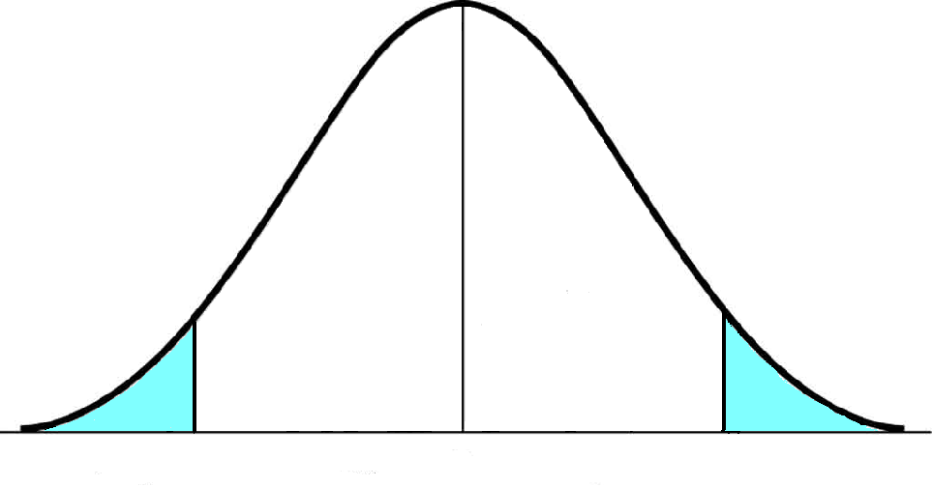
Recap: hypothesis testing with R, based on p-values
Two methods of conducting hypothesis testing :
By hand: Comparing the test statistic to the critical values (e.g., +/-1.96), both of which are Z-/t-scores.
Use R: comparing the p-value, i.e., probability of obtaining the sample statistic, to the alpha level (0.05 or 0.01), both of which are probabilities (area under the curve)
alpha level = error probability = the probability of a sample landing here is only 5% (2.5% on each side) = area under the curve
p-value = probability of obtaining the specific test statistic = area under the curve
95%
2.5%
2.5%
-1.96
Test statistic
-2.37
Critical values
+1.96

Slide 9
Recap: How to interpret p-values?
p-value measures the precise probability of getting a particular sample statistic (sample mean/percentage), assuming that H0 is true.
  p-value < 0.05 (or 0.01) → the probability of getting this specific sample statistic is too small (less than 5%) → H0 is likely NOT true → reject H0
  p-value >= 0.05 (or 0.01) → it’s likely to get this sample statistic ( >5% chance) → the difference is just due to natural variation → H0 is likely true → fail to reject H0 (“accept” H0)
  Reminders:
  Decisions about H0 can be made solely based on the test statistic (hand-calculated, compared to critical values) or the p-value (R output, compared to 0.05 or 0.01), but not BOTH.

Slide 10
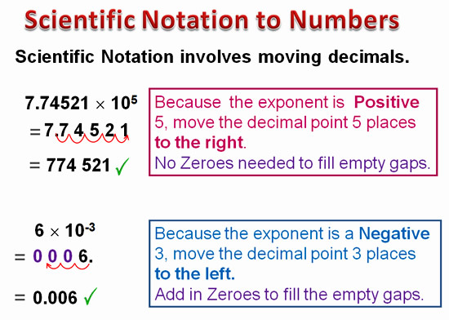
Read p-values in R outputs
You will look for the p-values in R outputs.
However, R writes p-values in a way called “scientific notation.”
How to read a scientific notation?
10 = 10¹, 100 = 10², 1000 = 10³; can be written as e+1, e+2, e+3
0.1 = 10⁻¹, 0.01 = 10⁻², 0.001 = 10⁻³; can be written as e-1, e-2, e-3
1234 = 1.234 x 1000 = 1234 x 10³ = 1.234 x e+3 = 1.234 e+3
0.05 = 5 x 0.01 = 5 x 10⁻² = 5 x e-2 = 5 e-2
0.01 = 1 x 0.01 = 1 x 10⁻² = 5 x e-2 = 1 e-2
Compared to 0.05 (5e-2) and 0.01 (1e-2)?
Any number times e-3 or more → definitely smaller than 0.01 and 0.05
4 e-1= 0.4
4 e-2= 0.04
4 e-3= 0.004 < 0.05 / 0.01
4 e-4= 0.0004 << 0.05/0.01
4 e-5= 0.00004 <<< 0.05/0.01

Slide 12
Extension 1: one-tailed v.s. two-tailed test
So far, the hypothesis testing we did were all two-tailed tests.
This type of test is non-directional.
Two tails
For example, if we are comparing the sample mean to the population mean, we hypothesize that the two values are (not) equal.
We do not care about the direction of the difference, for example, whether the sample mean is greater or smaller than the population mean.
Two-sided test is more common than one-sided test.
95%
2.5%
2.5%
-1.96
+1.96

Slide 13
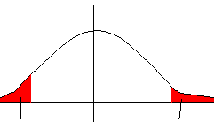
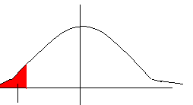

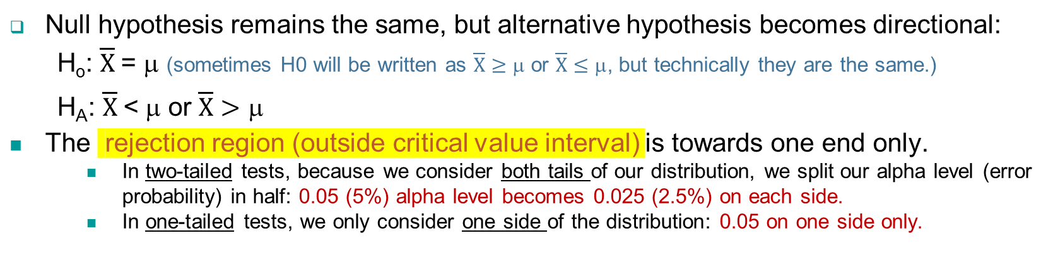


One-Tailed Tests
One-tailed test, by comparison, is directional → sample statistic is greater or smaller than hypothesized population parameter.
Null hypothesis remains the same, but alternative hypothesis becomes directional:
H_{o}: $\overline{X}$= μ (sometimes H0 will be written as $\overline{X}≥$ μ or $\overline{X}≤$ μ, but technically they are the same.)
H_{A}: $\overline{X}$< μ or $\overline{X}>$ μ
The rejection region (outside critical value interval) is towards one end only.
  In two-tailed tests, because we consider both tails of our distribution, we split our alpha level (error probability) in half: 0.05 (5%) alpha level becomes 0.025 (2.5%) on each side.
  In one-tailed tests, we only consider one side of the distribution: 0.05 on one side only.
95% level two-tailed
95% level one-tailed
2.5%
2.5%
Rejection region
Rejection region
5%
Rejection region

Slide 14
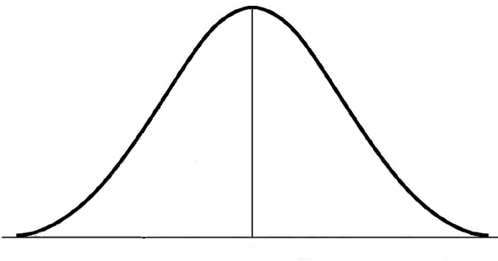
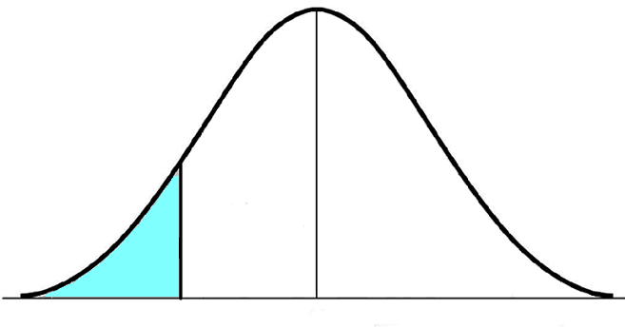
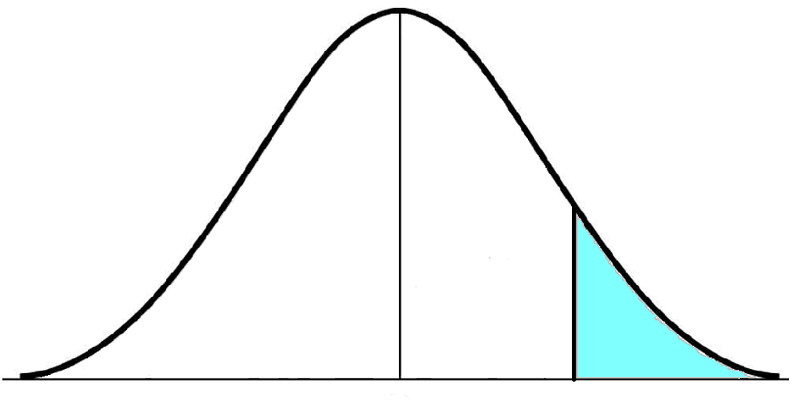
Test statistic < -1.65
→ reject H0
Test statistic > 1.65
→ reject H0
.05
.05
“smaller than” → lower end
“greater than” → upper end
95%
95%
-1.65
+1.65
Rejection Region
Rejection Region
Critical value interval:
[negative infinity, 1.65]
Critical value interval:
[-1.65, positive infinity]

Slide 15
Quick summary: α levels and critical values
In one-tailed tests, we only consider one side of the distribution.
→ For this reason, the critical values of z-scores are smaller than those in a two-tailed tests
 | Two- tailed | One-tailed Upper or Lower
.05 | [-1.96, 1.96] | > 1.65 < -1.65
.01 | [-2.58, 2.58] | > 2.33 < -2.33

Slide 16
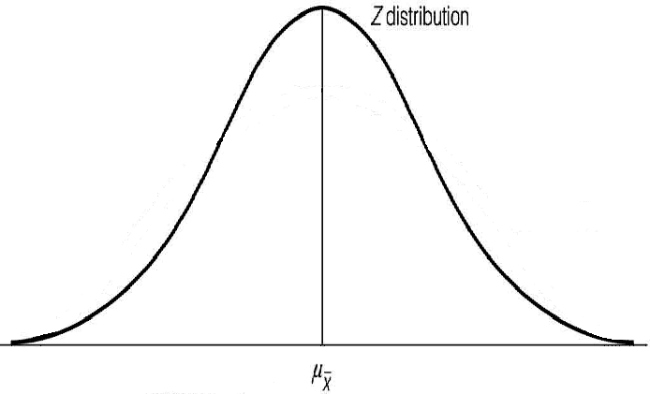
Critical values in one-tailed test is smaller than those in two-tailed tests
One-Tailed
5%
95%
Two-Tailed
95%
2.5%
-1.96
+1.65
+1.96
Notes:
16

Slide 17

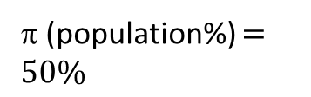
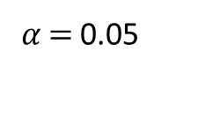

One-tailed Test
Example 1
A person wants to test whether a coin has exactly a 50% chance of landing on heads. A random sample of 100 coin-flips was taken, and they found that the 100 coin-flips were distributed as 45 heads and 55 tails.
Can we accept the hypothesis that a coin has less than 50% chance of landing on heads on the 0.05 alpha level?
Step 0: organize information
Info about sample
p (sample%) $=45\%$
Significance Level
Info about population
π (population%) $=50\%$
𝛼 $=$0.05
$$N=100$$

Slide 18
One-tailed Test
Example 1
Step 1: Construct Null and Alternative Hypothesis:
H₀: no difference between sample and population.
H₁: sample statistic is greater or smaller than population parameter.
H₀: p = π (same as π = 50%); There is no statistically significant difference between the hypothesized percentage of coins landing on heads (50%) and the sample percentage (45%) of coins landing on heads.
H₁: p < π (same as π < 50%); The sample percentage (45%) of coins landing on heads is significantly smaller than the hypothesized percentage of coins landing on heads (50%).

Slide 19
One-tailed Test
Example 1
Step 2: Determine the critical values.
- What is the confidence level?
Alpha level = 0.05 → confidence level = 95%
- Use Z-score or t-score (look-up table)?
N = 100 >= 100 → use Z-scores
- Smaller than or greater than?
Smaller than → lower end
The critical value interval of Z-scores = [-1.65, positive infinity]
.05
“smaller than” → lower end
95%
-1.65
Test statistic < -1.65
→ reject H0
Rejection Region
Critical Value

Slide 20
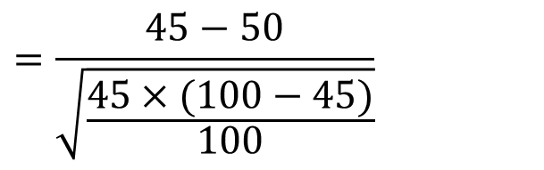
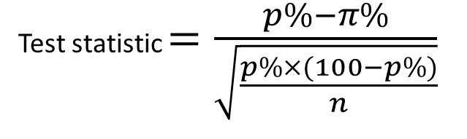
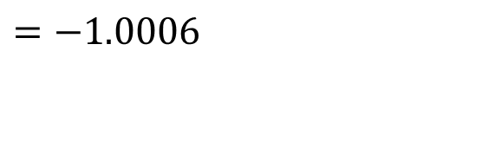
One-tailed Test
Example 1
Step 3: Calculate test statistic
Difference between sample and population percentage
Test statistic $=\frac{p\%−π\%}{\sqrt{\frac{p\%×(100−p\%)}{n}}}$
$$=\frac{45−50}{\sqrt{\frac{45×(100−45)}{100}}}$$
$$=−1.0006$$
SE for sample percentage

Slide 21
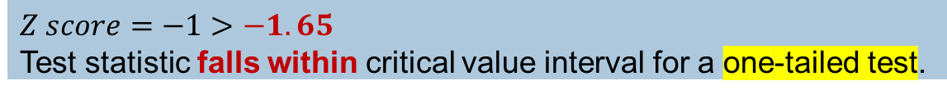
One-tailed Test
Example 1
Step 4: Compare test statistic to the critical values determined by the significance level
One-tailed, lower end, on the 0.05 level → critical value interval = [-1.65, positive infinity]
What is the result of the comparison?
$$Z score=−1>−1.65$$
Test statistic falls within critical value interval for a one-tailed test.
Step 5: Make a decision
Test statistic is greater than the critical value -1.65 on 0.05 level.
→ Fail to reject H0 (find support for H0) → The sample percentage is NOT significantly smaller than the population percentage.

Slide 22
One-tailed Test
Example 1: Interpretation
At the 0.05 significance level (OR: with a 95% confidence level), we fail to reject the null hypothesis and conclude that the sample percentage (45%) of landing on heads in the 100 coin-flips we took is NOT significantly smaller than the hypothesized percentage (50%) of getting heads in coin flips in general (OR: there is no actual difference between the two values). In other words, we are 95% confident that the true probability of a coin flip landing on heads is 50%.
… If we reject H0:
“We are 95% confident that the true probability of a coin flip landing on heads is smaller than 50%”

Slide 24
Extension 2: one-sample v.s. two-sample tests
So far, we only compared a sample statistic (mean/percentage) to a hypothesized population parameter (mean/proportion).
  It is called a one-sample test (i.e., compare one sample to the population).
But the same rules and procedures can be easily extended to compare the means or percentages of two groups.
  It is called a two-sample test (i.e., compare sample 1 to sample 2).
  For instance: is there a significant difference between boys’ heights and girls’ heights?
  We probably see some difference between the two groups in our sample data.
  However, does the difference exist on the population level as well? (Is the difference significant?)

Slide 25
Two sample tests and A/B tests
Two-sample tests are widely applied in different industries to test products, investigate user experience, or help make marketing decisions.
- for a social media app like Instagram, which home page design is more attractive: A or B?
- for an online advertisement, which group is more likely to click it: A or B?
- for a search engine like Google, what is the optimal number of results to display? 25 per page or 50 per page?
…
Such tests are usually called “A/B tests”, as they typically consist of a randomized experiment that includes the comparison of two options (A and B).
While experiment design is beyond the scope of this class, you are equipped to carry out the required statistical hypothesis testing behind the A/B tests – that is, two-sample tests.

Slide 26
Two-sample test
Step 0: Organize information
Step 1: Construct the null and alternative hypothesis
H0: There is no significant difference between the two groups. (diff = 0)
H1: There is a significant difference between the two groups. (diff ≠ 0)
A two-sample test is usually two-tailed.

Slide 27
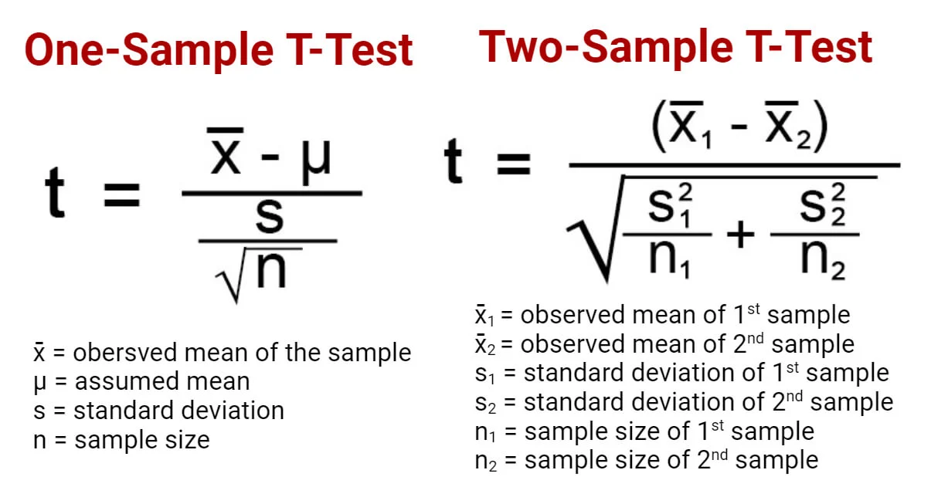
Two-sample test
Step 2: calculate the test statistic – t-score
To test if the difference actually exists in the population, we need a Students T-test based on t-scores.

Slide 28
Two sample test (A/B test)
Step 3: Compare the test statistic to the critical values determined by the confidence level.
Since we have two groups, the degree of freedom (df) of the critical t-score is
df = (n1 – 1) + (n2 – 1)
Where n1 is the sample size of the first group, and n2 is the sample size of the second group.
Then you will look up the t-table for the critical values.
Step 4: Make a decision (two-tailed)
- If the test statistic falls outside of the critical value interval [-x.xx, x.xx], reject H0.
- If the test statistic falls within the critical value interval [-x.xx, x.xx], fail to reject H0.

Slide 29
Using R For hypothesis testing
In this class, you are required to:
- Conduct one-sample one-tailed and two-tailed tests by hand and with R.
- Conduct two-sample tests (two-detailed by default) with R only.
R makes the process easy –
but if you don’t understand the step-by-step hand calculation process, you will NOT be able to interpret the R outputs.

Slide 30
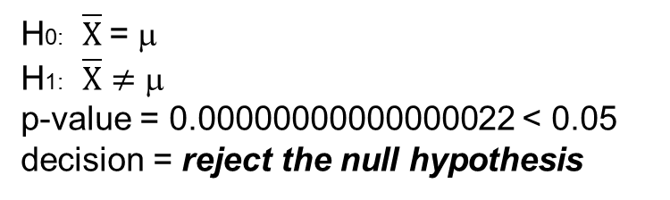
Recap: R for one-sample, two-tailed tests
> t.test(gss$age, # variable for test
mu=40) # population mean (H0)
One Sample t-test
data: gss$age
t = 12.148, df = 999, p-value < 2.2e-16
alternative hypothesis: true mean is not equal to 40
95 percent confidence interval: 45.27813 47.31187
sample estimates:
mean of x
46.295
By default, R uses a 95% confidence level.
t: test statistic t-score (z-score is just a special case of t-score)
df: degree of freedom = sample size – 1
p-value: the probability of obtaining the sample mean if H0 were true.
alternative hypothesis: H1 (you need to specify H0 by yourself.)
95 percent CI: the CI of the sample mean
sample estimates: the sample mean
H0: $\overline{X}$= μ
H1: $\overline{X}≠$ μ
p-value = 0.00000000000000022 < 0.05
decision = reject the null hypothesis

Slide 31

Using R for one sample, one-tailed tests
H1: Choose between “less” or “greater”
By default, R uses a 95% confidence level.
H0 : mu = 40 (or mu >= 40)
H1 : mu < 40 (x_bar < mu)
p-value = 1 (> 0.05 or 0.01)
decision = fail to reject H0 (“accept” H0)
Note: you only need p-values to make the decision.
If conducting it by hand, you’ll need the test statistic.
Test statistic = ?
12.148
Compared to which critical value?
– 1.65
> t.test(gss$age, mu=40, alternative = “less" )
One Sample t-test
data: gss$age
t = 12.148, df = 999, p-value = 1
alternative hypothesis: true mean is less than 40
95 percent confidence interval: -inf 47.14814
sample estimates:
mean of x
46.295

Slide 32
Using R for two-sample Tests
> t.test(gss$educ[gss$sex=='Female’], # group x gss$educ[gss$sex=='Male'] ) # group y
Welch Two Sample t-test
data: gss$educ[gss$sex == "Female"] and gss$educ[gss$sex == "Male"]
t = -1.3095, df = 812.54, p-value = 0.1907
alternative hypothesis: true difference in means is not equal to 0
95 percent confidence interval: -0.7090340 0.1415686
sample estimates:
mean of x mean of y
13.33934 13.62308
Is there a difference in females’ and males’ educational achievements?
By default, R uses a 95% confidence level.
95% confidence interval = lower and upper bound of the difference between the means
sample estimates = sample mean for each group
Mean of x: avg educ for females
Mean of y: avg educ for males
H0: ?
H1: ?
P-value:? Compared to??
Decision:?

Slide 33
Interpretation
> t.test(gss$educ[gss$sex=='Female’], # group x gss$educ[gss$sex=='Male'] ) # group y
Welch Two Sample t-test
data: gss$educ[gss$sex == "Female"] and gss$educ[gss$sex == "Male"]
t = -1.3095, df = 812.54, p-value = 0.1907
alternative hypothesis: true difference in means is not equal to 0
95 percent confidence interval: -0.7090340 0.1415686
sample estimates:
mean of x mean of y
13.33934 13.62308
Is there a difference in females’ and males’ educational achievements?
H0: no diff. between F and M’s educ level.
H1: significant diff. b/t F and M’s educ level.
P-value: 0.19 >> 0.05
Decision: we fail to reject the null hypothesis H0.
Interpretation
With a 95% confidence level (OR: at the 0.05 significance level), we fail to reject the null hypothesis and conclude that there is NO significant gender difference in terms of educational levels in the American population in 2006.

Slide 35
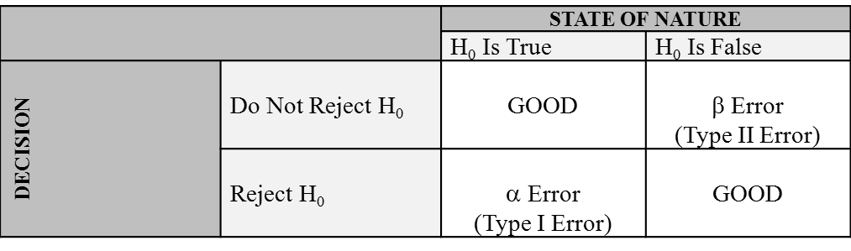
Type I and Type II Errors
  You commit an α error, or Type I error, if you reject H₀ when it is actually true.
  You commit a β error, or Type II error, if you “accept” H₀ when it is actually false.

Slide 36
Type I and Type II Errors
Type I error (False positive)
  occurs when we believe that there is a pattern in the population when there actually isn’t.
  The probability is the α-level (usually 0.05 or 0.01)
  Example: Probability of sending an innocent person to jail (finding guilt when there isn’t any)
  In hypothesis testing, this is a case of wrongly rejecting the null hypothesis.
Type II error (False negative)
  occurs when we believe that the pattern does not exist in the population when there actually is.
  The probability is the β-level (often 0.2)
  Example: Probability of letting a guilty person go free (not finding guilt when there is guilt)
  In hypothesis testing, this is a case of wrongly “accepting” the null hypothesis.

Slide 37
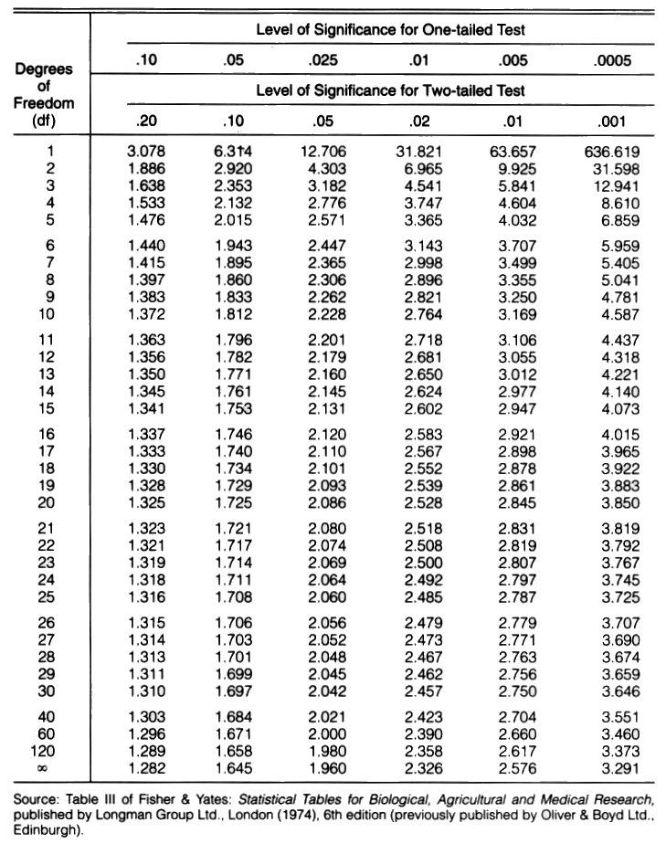


How to use the t-table to look up critical values.
The table shows critical values for both
One-tailed test (first header)
&
Two-tailed test (second header)
First locate the correct test type, then look for the chosen alpha level.
𝛼 level
The table only shows positive numbers.
However, for two-tailed test, the critical values are [-x.xx, +x.xx]
For one-tailed test (first header)
“Smaller than”: take negative value – x.xx
“Larger than”: take positive value + x.xx
Df = sample size – 1
Z-score = t-score when sample size >= 100

Slide 39
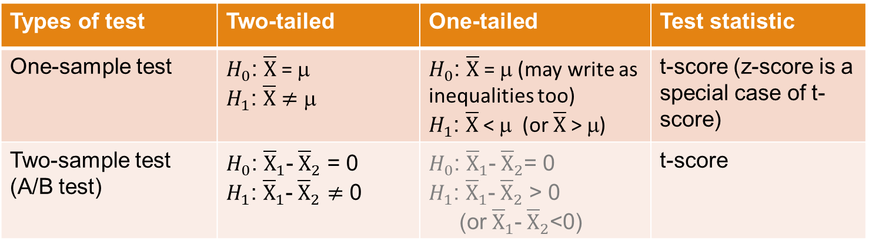
Recap
Different types of hypothesis testing:
By hand: compare test statistic to the critical values at 95% (or 99%) CL.
With R: compare p-value to 0.05 (or 0.01)
- p-value < 0.05: reject H0
- p-value >= 0.05: fail to reject H0 (“accept” H0)
Types of test | Two-tailed | One-tailed | Test statistic
One-sample test | $H_{0}$: $\overline{X}$= μ $H_{1}$: $\overline{X}≠$ μ | $H_{0}$: $\overline{X}$= μ (may write as inequalities too) $H_{1}$: $\overline{X}$< μ (or $\overline{X}$> μ) | t-score (z-score is a special case of t-score)
Two-sample test (A/B test) | $H_{0}$: ${\overline{X}}_{1}$-${\overline{X}}_{2}$ = 0 $H_{1}$: ${\overline{X}}_{1}$-${\overline{X}}_{2}≠$ 0 | $H_{0}$: ${\overline{X}}_{1}$-${\overline{X}}_{2}$= 0 $H_{1}$: ${\overline{X}}_{1}$-${\overline{X}}_{2}$ > 0 (or ${\overline{X}}_{1}$-${\overline{X}}_{2}$<0) | t-score

Slide 40
Assignment
Blackboard Assignment “HW8”
- 5 points total.
Deadline: April 26, Sunday, 11:59 pm
Submit to Brightspace. Email submissions not accepted.

